Slide 1
Digital Engineering 1
Lecture 3

Slide 2
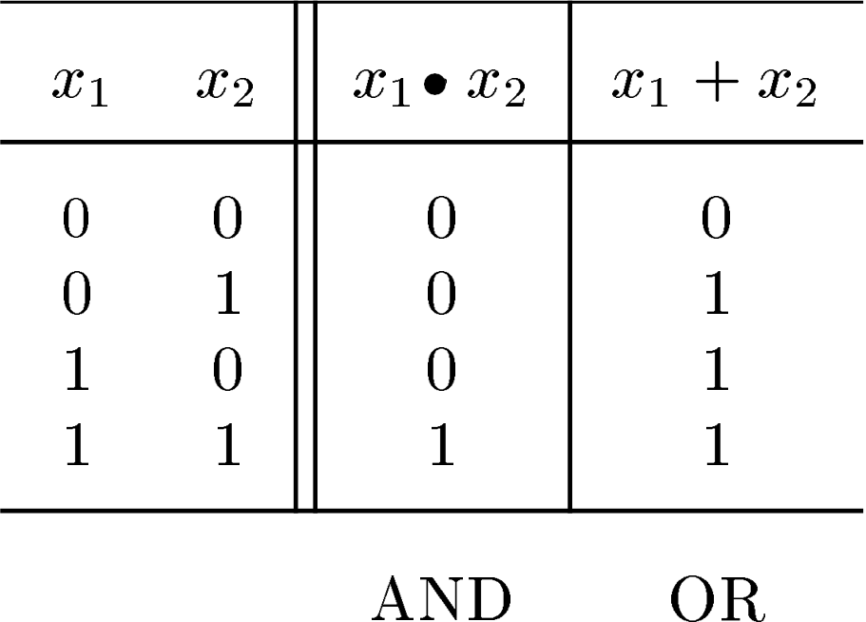
Truth Table

Slide 3
Boolean Algebra
Named after George Boole
Axioms
0 · 0 = 0
0 + 0 = 0
0’ = 1
Duality
1 · 1 =1
1 + 1 = 1
1’ = 0
0 + 1 = 1 + 0 = 1
0·1 = 1·0 = 0

Slide 4
Single Variable Theorems
x | · | 0 | = 0
x | + | 1 | = 1
x | · | 1 | = x
x | + | 0 | = x
x | · | x | = x
x | + | x | = x
x | + | !x | = 1
x | · | !x | = 0
x | · | x | x · … x = x
!!x = x

Slide 5
Two Variable Theorems
x | · | y | = | y | · | x
x | + | y | = | y | + | x
Both are commutative

Slide 6
Three Variable Theorems
Associative Laws
x | · | (y | z) | = | (x | · | y) | · | z
x | + | (y | + z) | = | (x | + | y) | + | z
Distributive Law
x · (y + z) = (x
· y) + (x · z)
x + (y · z) = (x + y) · (x + z)

Slide 7
DeMorgan’s Theorem
(X₁ + X₂ + ... + X_{n} ) = X₁ ⋅ X₂ ⋅ ... ⋅ X_{n}
(X₁ ⋅ X₂ ⋅ ... ⋅ X_{n} )
= X₁ + X₂ + ... + X_{n}
Note that
X ⋅Y ≠ X ⋅Y
X + Y ≠ X + Y

Slide 8
Proof Techniques
(Example 1)
Prove x + (y·z) = (x + y) · (x + z)
RHS = x · (x+z) + y · (x+z)
= x·x + x·z + y·x + y·z
= x·(1+z+y) + y·z
= x·(1)+ y.z
= x + y.z
Fairly Straightforward

Slide 9
Proof Techniques
(Example 1)
Prove x + (y·z) = (x + y) · (x + z)
RHS = x · (x+z) + y · (x+z)
= x·x + x·z + y·x + y·z
= x·(1+z+y) + y·z
= x·(1)+ y.z
= x + y.z
Fairly Straightforward

Slide 10
Proof Techniques
Introduce a constant
(Example 2)
Prove x + x · y = x
x + x · y = x · 1 + x · y
= | x | (1 | + | y)
= | x | ·1
= | x

Slide 11
Proof Techniques
(Example 3)
Prove x.y + y.z + x’.z = x.y + x’.z
LHS = x.y + y.z.1 + x’.z
= x.y + y.z.(x+x’) + x’.z
= x.y + y.z.x + y.z.x’ + x’.z
= x.y (1 + z) + (y + 1) .x’.z
= x.y + x’.z
Introduce a constant and introduce a function

Slide 12
Boolean Techniques
(Example 4)
Simplify x.y + x.y.z + y.z
LHS | = | x.y | + | x.y.z | + | y.z
 | = | x.y | + | x.y.z | + x.y.z | + y.z
= x.y (1 + z) + y.z (x + 1)
= x.y + y.z
= y.(x+z)
Introduced a copy of a term
A simpler derivation is there. Think about it!

Slide 13
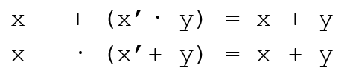
Prove the Two Variable Theorems Below
Absorption
x | + | (x | · | y) | = | x
x | · | (x | + | y) | = | x
Combining
x · y + x · y’ = x
(x + y)· (x + y’) = x
DeMorgan’s Laws
(x + y)’ = x’· y’
(x · y)’ = x’+ y’

Slide 14
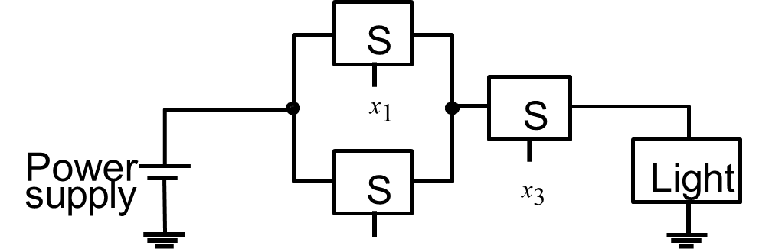
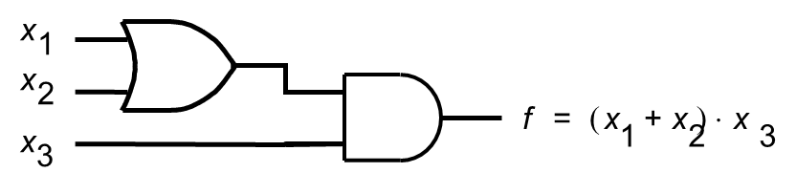
Boolean Functions
x₂

Slide 15
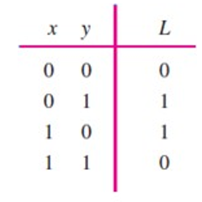
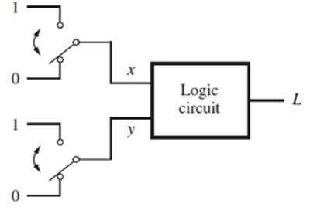
Design Problem 1
Design a circuit for staircase light control using a two-way switch
If both switches are OFF or ON, light is off
If one of them is ON and another is OFF, the light is ON
Truth table
System

Slide 16
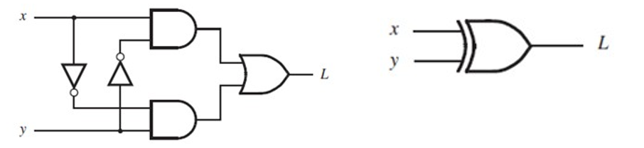
Design Problem 1
Logic Network
XOR gate

Slide 17



Design Problem 2
Design a circuit which realizes the following truth table
f = ?

Slide 18
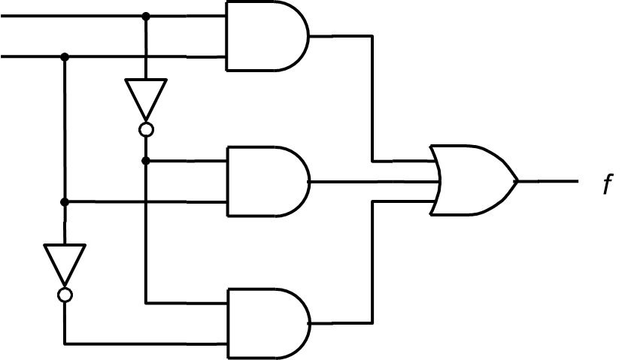
Design Problem 2 (contd.)
f = x1’.x2’ + x1’.x2 +x1.x2
x1
x2

Slide 19
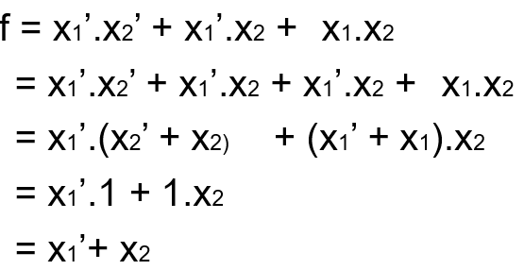
Let’s simplify it
x₁ x₂
f

